Slide 1


Macroeconomics
Ninth Edition
Chapter 7
Comparative Advantage and the Gains from International Trade
Copyright © 2025, 2021, 2018 Pearson Education, Inc. All Rights Reserved
Notes:
If this PowerPoint presentation contains mathematical equations, you may need to check that your computer has the following installed:
1) MathType Plugin
2) Math Player (free versions available)
3) NVDA Reader (free versions available)

Slide 2
Chapter Outline
7.1 The United States in the International Economy
7.2 Comparative Advantage in International Trade
7.3 How Countries Gain from International Trade
7.4 Government Policies That Restrict International Trade
7.5 The Debate over Trade Policies and Globalization

Slide 3
Are We Facing the End of Globalization?
Most large U.S. corporations have substantial foreign sales, as do their global counterparts.
The extensive flow of imports and exports around the world is the result of globalization—countries becoming more open to foreign trade and investment.
Recently some countries have adopted more “protectionist” policies. Supply chain disruptions and increasing political tensions have also led to decreased trade.

Slide 4
7.1 The United States in the International Economy
Discuss the role of international trade in the U.S. economy.
International trade has grown more and more important to the world economy over the past 50 years.
Falling shipping, transportation, and communication costs have made international trade more profitable and desirable. Many governments have also changed policies to facilitate trade.
Traditionally, countries imposed high tariffs on imports, believing that such measures made their own firms and consumers better off.
But that meant their exports were similarly taxed.
Tariff: A tax imposed by a government on imports.
Imports: Goods and services bought domestically but produced in other countries.
Exports: Goods and services produced domestically but sold in other countries.

Slide 5
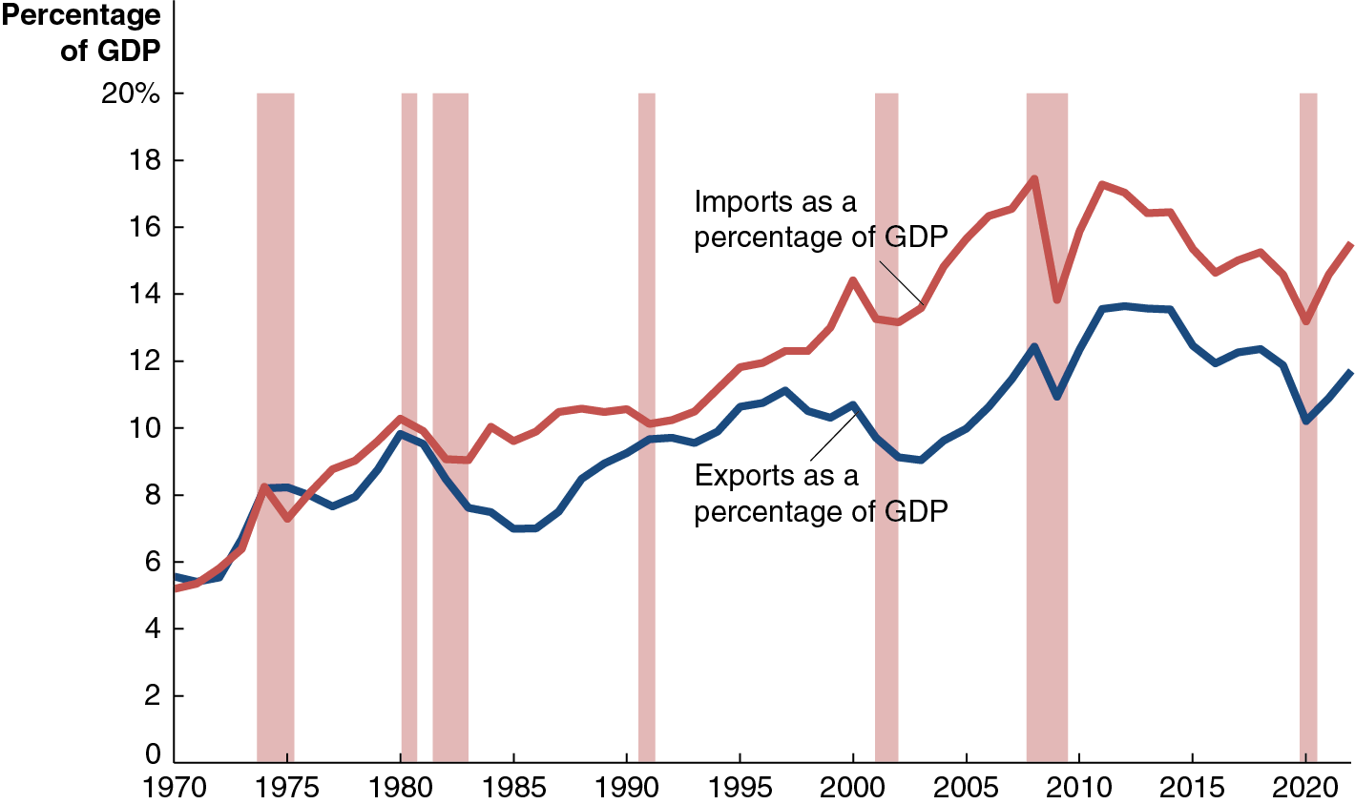
Figure 7.1 The Increasing Importance of International Trade to the United States
From 1970 to the late 2000s, imports and exports were rising as a fraction of U.S. gross domestic product (G D P), increasing the importance of international trade to the U.S. economy.
World trade declined sharply with the Great Recession of 2007-2009. The importance of trade to the U.S. economy has stayed about the same since then.
Notes:
The horizontal axis ranges from 1970 to 2020 in increments of 5 years. The vertical axis plots the percentage of G D P and ranges from 0 to 20% in increments of 2%. The graph plots two curves. The curve for imports as a percentage of G D P starts at (1970, 5.5), rises and falls intermittently, and passes through (1975, 8), (1980, 10), (1985, 9.3), (1990, 10), (1995, 12), (2000, 14.2), (2005, 15.9), (2010, 15), (2015, 14.8), and (2020, 13.6). The curve for exports as a percentage of G D P starts at (1970, 5.7), rises and falls intermittently, and passes through (1975, 8), (1980, 9.7), (1985, 7), (1990, 9), (1995, 10.2), (2000, 9.8), (2005, 9), (2010, 12.2), (2015, 12), and (2020, 10.2). All values are estimated.

Slide 6
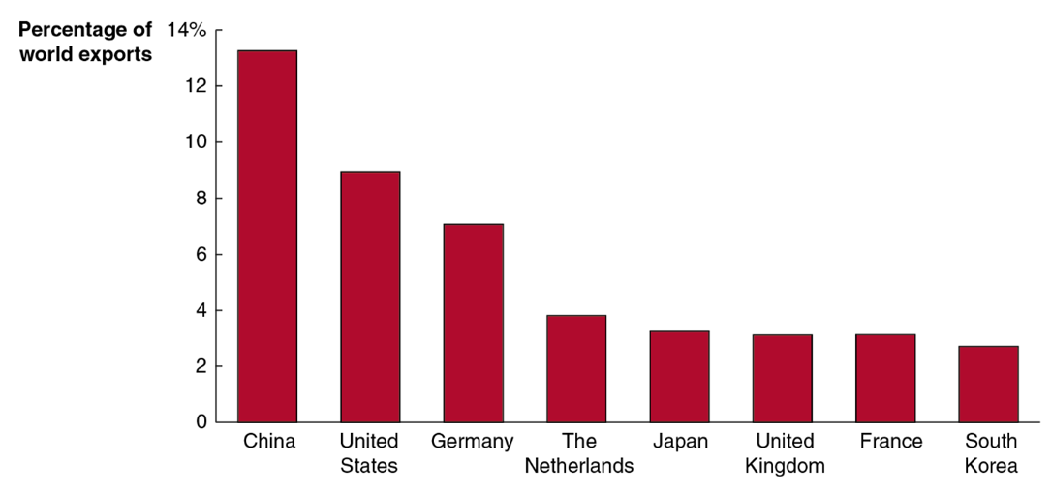
Figure 7.2 The Eight Leading Exporting Countries
The rapid growth of the Chinese economy has made it the world’s largest exporter, with 13.3 percent of world exports.
China took over the lead from the U.S., which accounts for 8.9 percent of world exports.
Notes:
The horizontal axis plots the selected countries. The vertical axis ranges from 0 to 14% in increments of 2%. The data plotted are as follows.
China, 13.5%
United States, 8.4%
Germany, 6.4%
The Netherlands, 3.9%
Japan, 3.6%
United Kingdom, 3.3%
France, 3.3%
South Korea, 3%

Slide 7
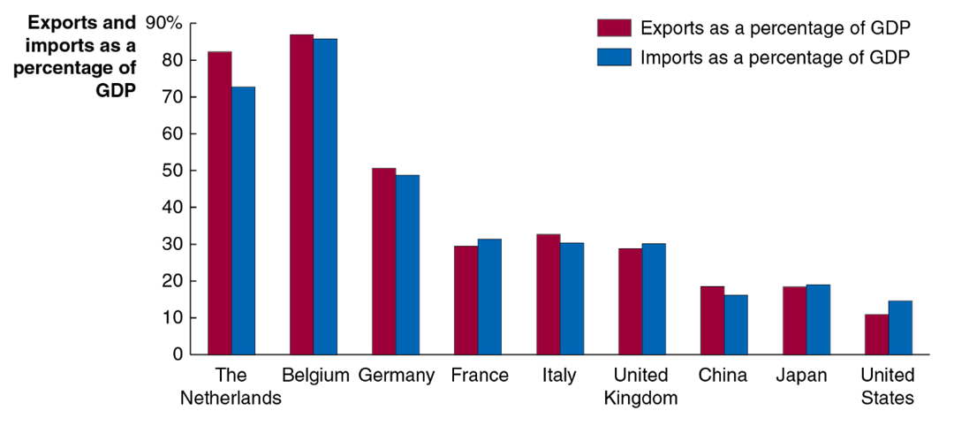
Figure 7.3 International Trade as a Percentage of G D P
Trade makes up a relatively small part of the economy for the United States (and China, to a lesser extent), especially compared with smaller countries.
This is mostly due to the relative sizes of the economies.
Notes:
The horizontal axis plots the selected countries. The vertical axis plots the exports and imports as a percentage of G D P. The data plotted are as follows.
The Netherlands. Exports as a percentage of G D P, 81%. Imports as a percentage of G D P, 71%.
Belgium. Exports as a percentage of G D P, 86%. Imports as a percentage of G D P, 85%.
Germany. Exports as a percentage of G D P, 51%. Imports as a percentage of G D P, 49%.
France. Exports as a percentage of G D P, 30%. Imports as a percentage of G D P, 31%.
Italy. Exports as a percentage of G D P, 32.5%. Imports as a percentage of G D P, 30%.
United Kingdom. Exports as a percentage of G D P, 29%. Imports as a percentage of G D P, 30%.
China. Exports as a percentage of G D P, 16.5%. Imports as a percentage of G D P, 18%.
Japan, Exports as a percentage of G D P, 18.5%. Imports as a percentage of G D P, 19%.
United States. Exports as a percentage of G D P, 10%. Imports as a percentage of G D P, 15%.

Slide 8
7.2 Comparative Advantage in International Trade
Explain the difference between comparative advantage and absolute advantage in international trade.
Comparative advantage is the ability of an individual, a firm, or a country to produce a good or service at a lower opportunity cost than competitors.
The comparative advantage arises from having a lower opportunity cost than your competitor.
Opportunity cost: The highest-valued alternative that must be given up to engage in an activity.

Slide 9
Table 7.1 An Example of U.S. Workers Being More Productive Than Chinese Workers
Blank | Output per Hour of Work Smartphones | Output per Hour of Work Wheat (bushels)
China | 4 | 2
United States | 6 | 12
The U.S. has an absolute advantage in producing both smartphones and wheat.
Absolute advantage: The ability of an individual, a firm, or a country to produce more of a good or service than competitors, using the same amount of resources.
But comparative advantage means that trade can still be advantageous for both nations.

Slide 10
Table 7.2 The Opportunity Costs of Producing Smartphones and Wheat
Blank | Opportunity Costs Smartphones | Opportunity Costs Wheat (bushels)
China | 0.5 bushel of wheat | 2 smartphones
United States | 2 bushels of wheat | 0.5 smartphone
This table shows what has to be given up to create each good: the opportunity cost.
If the nations were in autarky, a situation in which a country does not trade with other countries, these would also be the relative prices in each country: a smartphone would trade for half the price of a bushel of wheat in China and double the price of a bushel of wheat in America.
China would like to trade its smartphones for U.S. wheat, and vice versa.

Slide 11
7.3 How Countries Gain From International Trade
Explain how countries gain from international trade.
If countries did not trade, they would consume what they produced.
But if countries have different opportunity costs, they might each be willing to trade some of what they have a comparative advantage at producing for what the other country is (relatively) good at producing.
Both countries might be made better off by such a trade.

Slide 12
Table 7.3 Production Without Trade
Blank | Production and Consumption Smartphones | Production and Consumption Wheat (bushels)
China | 1,000 | 1,500
United States | 1,500 | 9,000
Suppose that initially, each country has 1,000 hours to spend.
In that time, China might produce 1,000 smartphones and 1,500 bushels of wheat.
At the same time, the U.S. might produce 1,500 smartphones and 9,000 bushels of wheat.
In total, 2,500 smartphones and 10,500 bushels of wheat are produced.

Slide 13
Production in Autarky—Preparing for Trade
Production and Consumption A right arrow | Smartphones | Wheat
China | 4,000 | 0
United States | 0 | 12,000
Observe what happens if each country specializes in its comparative advantage:
China can produce 4,000 smartphones.
The U.S. can produce 12,000 bushels of wheat.
In total, 4,000 smartphones and 12,000 bushels of wheat are produced.
Observe that more of both goods are produced.

Slide 14
Deciding on Terms of Trade
The terms of trade is the ratio at which a country can trade its exports for imports from other countries.
No country would accept terms of trade worse than its opportunity cost—it would be better off producing by itself the goods that it was importing.
Terms of trade of one-for-one could be acceptable to both China and the United States.
With these terms, they might trade 1,500 smartphones for 1,500 bushels of wheat, ending with the consumption on the following slide:

Slide 15
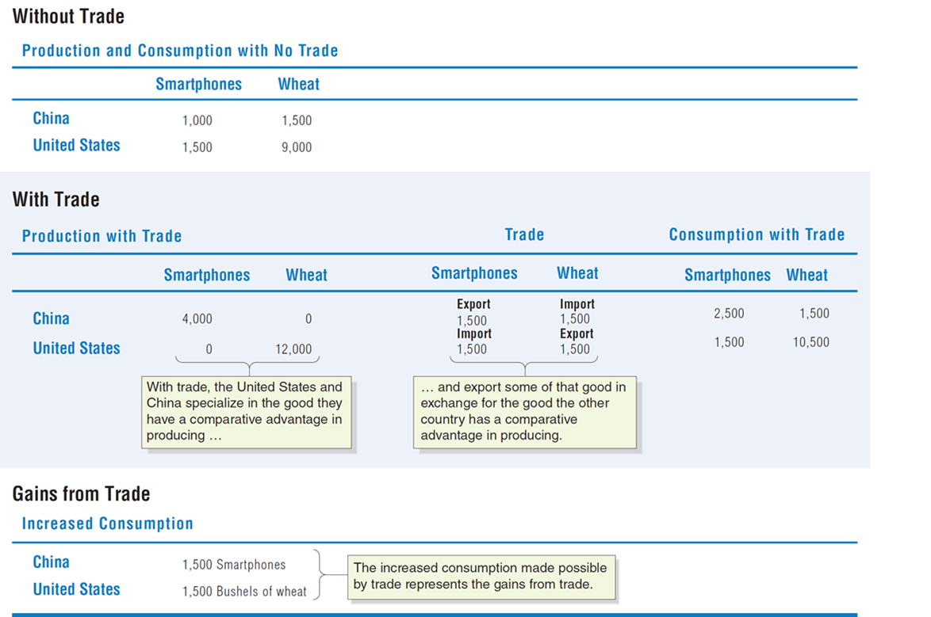
Table 7.4 Gains From Trade for China and the United States
Notes:
The table titled, without trade. Production and consumption with no trade is as follows. The table has 2 rows and 3 columns. The columns have the following headings from left to right. Countries, Smartphones, Wheat. The Row entries are as follows. Row 1. China, 1,000, 1,500. Row 2. United States, 1,500, 9,000. The table titled, with trade. Production with trade is as follows. The table has 2 rows and 7 columns. The columns have the following headings from left to right. Countries, smartphones, wheat, Trade, Smartphones, Trade, Wheat, Consumption with trade, smartphone, Consumption with trade, wheat. The row entries are as follows. Row 1. China, 4,000, 0, Export 1,500, Import 1,500, 2,500, 1,500. Row 2. United States, 0, 12,000, Import 1,500, Export 1,500, 1,500, 10,500. The values of smartphones and wheat for United States and China are labeled, with trade, the United States and China specialize in the good they have a comparative advantage in producing, and so on. The import and export values of United States and China are labeled, ellipsis and export some of that good in exchange for the good the other country has a comparative advantage in producing. Gains from trade. Increased consumption. China, 1,500 smartphones. United States, 1,500 bushels of wheat. The increased consumption made possible by trade represents the gains from trade.

Slide 16
Why Don’t We See Complete Specialization?
In the real world, products are not generally produced by only one nation. Reasons include:
Not all goods and services can be traded internationally (medical services, for example).
Production of many goods involves increasing opportunity costs (so small amounts of production are likely to take place in several countries).
Tastes for products differ (cars, for example); countries might have comparative advantages in different sub-types of products.

Slide 17
Does Anyone Lose as a Result of International Trade?
So far, we have made it appear that international trade is going to be good for everybody.
But this is true only on a national level.
Some individual firms and consumers will lose out due to international trade. In our example:
Chinese wheat farms and their workers
U.S. smartphones firms and their workers
These groups would likely ask their governments to implement protectionist measures like tariffs and quotas in order to protect them from foreign competition.

Slide 18
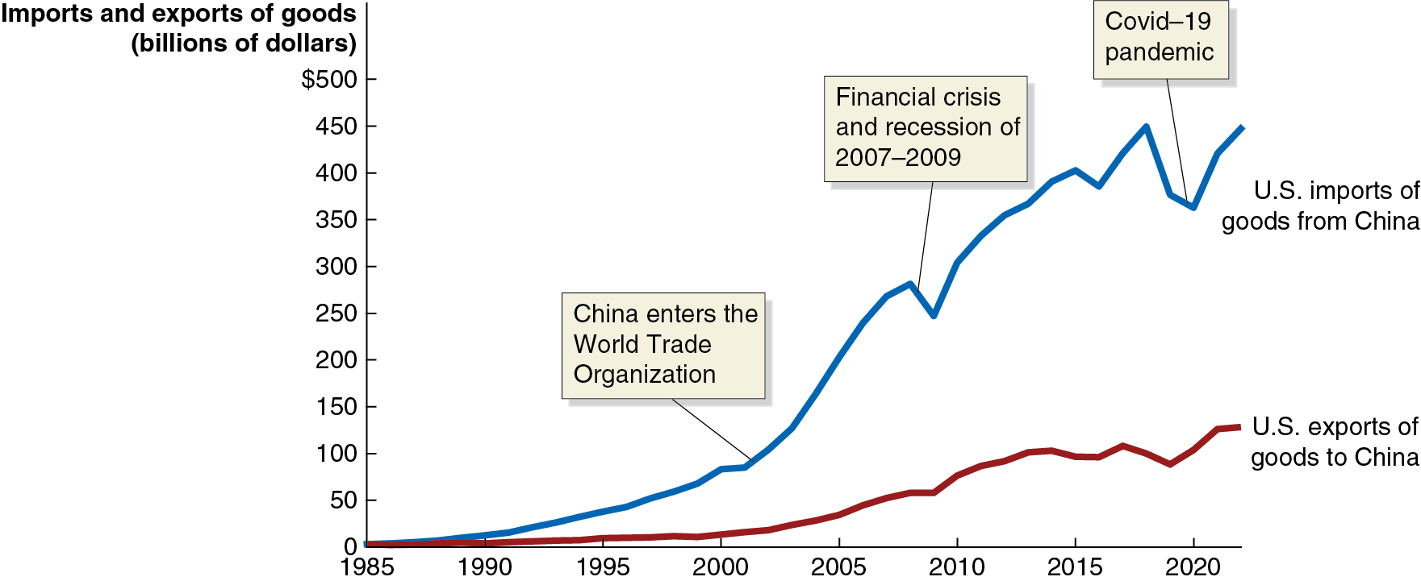
Apply the Concept: Who Gains and Who Loses from U.S. Trade With China? (1 of 3)
As China has adopted more market-based reforms, its exports have increased greatly.
Chinese exports to the United States are now worth many times more than U.S. exports to China.
Notes:
The X axis represents years ranging from 1985 to 2020 in increments of 5 years. The Y axis represents imports and exports of goods, in billions of dollars, and ranges from 0 to $500 in increments of $50. The line representing United States exports of goods to China begins at (1985, 1), rises steadily through (1990, 1), (1995, 5), (2000, 9), (2005, 26), (2010, 72), (2015, 100), and (2020, 135). The line representing United States imports of goods from China begins at (1985, 1), rises through (1990, 7), (1995, 48), (2000, 74), (2005, 200), (2010, 305), (2015, 390), and (2020, 360). 2002 is labeled, China enters the World Trade Organization. The financial crisis and recession from 2007 to 2009 is highlighted. Covid 19 Pandemic is highlighted.

Slide 19
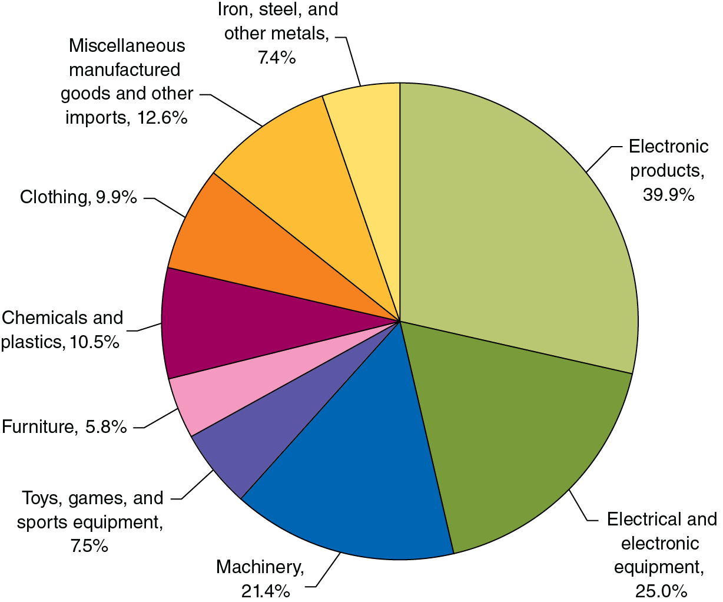
Apply the Concept: Who Gains and Who Loses from U.S. Trade With China? (2 of 3)
Many of the goods imported from China were previously manufactured in the U.S.
Lower-income consumers benefit from the increased availability of these goods; so do the firms at which they spend their saved money.
Notes:
The data plotted are as follows.
Electronic products, 39.9%
Electrical and electronic equipment, 25.0%
Machinery, 21.4%
Toys, games, and sports equipment, 7.5%
Furniture, 5.8%
Chemicals and plastics, 10.5%
Clothing, 9.9%
Miscellaneous manufactured goods and other imports, 12.6%
Iron, steel, and other metals, 7.4%

Slide 20
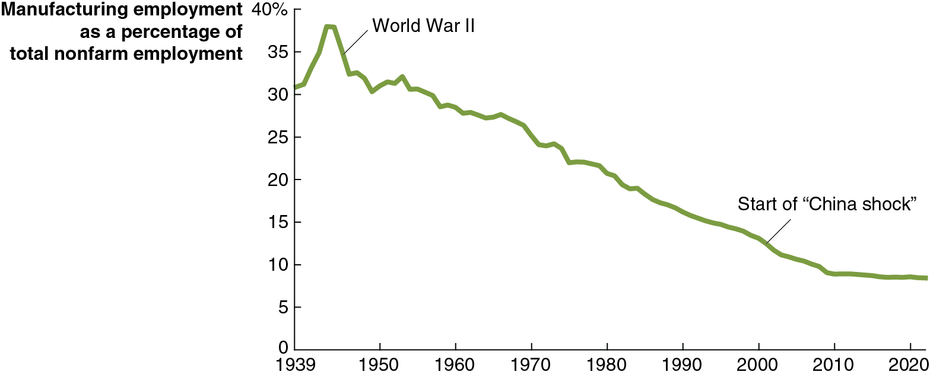
Apply the Concept: Who Gains and Who Loses from U.S. Trade With China? (3 of 3)
The increased competition from Chinese manufacturers has hurt many U.S. manufacturing firms and their workers; though manufacturing employment had been falling long before the “China Shock” began in around 2001. The effect of the China Shock has been greatest in the Midwest and Southeast.
Notes:
The X axis represents years ranging from 1939 to 2020 in increments of 10. The Y axis represents manufacturing employment as a percentage of total non farm employment and ranges from 0 to 40% in increments of 5%. The graph plots a line that starts at (1939, 31) and has a small gain during World War 2 to (1944, 37). From then the line falls steadily reaching 14 by 2000 at the start of the China Shock, (2010, 10), and stabilizes at (2020, 8.3). All values are estimated.

Slide 21
Where Does Comparative Advantage Come From? (1 of 2)
Comparative advantage can derive from a variety of sources:
Climate and natural resources
Some nations are better suited to particular types of production; particularly important for agricultural goods.
Example: Bananas in Costa Rica versus wheat in the U.S.
Relative abundance of labor and/or capital
Some nations have a lot of high- or low-skilled workers, or relatively much or little infrastructure.
Example: China has many low-skilled workers, versus relatively many high-skilled workers in the U.S.

Slide 22
Where Does Comparative Advantage Come From? (2 of 2)
Comparative advantage can derive from a variety of sources:
Technological differences
Technologies may not diffuse quickly or uniformly.
Example: U.S. is strong in product technologies—the ability to develop new products; Japan is strong in process technologies, involving the ability to improve processes to make existing products
External economies
External economies are reductions in a firm’s costs that result from an increase in the size of an industry.
Examples: Silicon Valley, Hollywood, Swiss watchmakers

Slide 23
7.4 Government Policies That Restrict International Trade
Analyze the economic effects of government policies that restrict international trade.
When a country loses its comparative advantage in producing a good:
Its income will be higher from the goods it does have a comparative advantage at producing.
It can consume the goods other countries are relatively good at making, at a lower cost.
This suggests countries should not produce goods at which they do not have a comparative advantage.
But there is often political pressure on governments to preserve industries that have lost their comparative advantage, or that never had one in the first place.

Slide 24
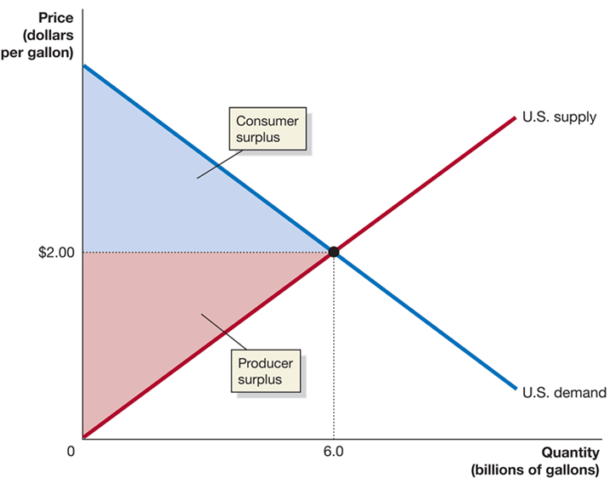
Figure 7.4 The U.S. Market for Ethanol under Autarky
If trade is not allowed in the U.S. market for ethanol, all domestic consumption will be met by domestic production.
Consumers who are willing to pay at least $2.00 per gallon purchase ethanol and obtain consumer surplus.
Domestic producers with costs lower than $2.00 per gallon sell their ethanol and obtain producer surplus.
Notes:
The X-axis represents quantity in billions of gallons, and the Y-axis represents price in dollars per gallon. The supply and demand curves for the United States intersect at (6.0, $2.00). The red area between (0, 0), (0, $2.00), and (6.0, 0) represents the producer surplus. The blue area between (0, $2.00), (0. 3.00), and (6.0, 0) represents the consumer surplus.

Slide 25
Joining the Global Ethanol Market
Now suppose the U.S. government adopts free trade policies in the market for ethanol, allowing unlimited imports and/or exports.
Free trade: Trade between countries that is without government restrictions.
Assume that the world price of ethanol is $1.00 per gallon:
U.S. consumers will import ethanol, benefiting from the lower price.
U.S. ethanol producers will suffer, receiving a lower price.
How can we decide whether allowing free trade makes Americans better off overall?
By comparing the economic surplus in the market with and without free trade.

Slide 26
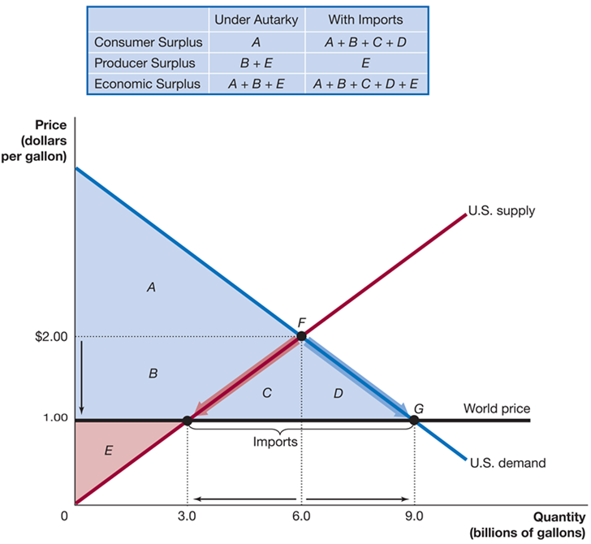
Figure 7.5 The Effect of Imports on the U.S. Ethanol Market
When imports are allowed, the price falls to $1.00 per gallon.
U.S. production falls to 3.0 billion; U.S. consumption rises to 9.0 billion.
Therefore, 6.0 million gallons are imported.
Consumer surplus rises to A+B+C+D.
Producer surplus falls to E.
Overall, economic surplus rises; the gains to consumers outweigh the losses to producers.
Notes:
The table has 3 rows and 2 columns. The columns have the following headings from left to right: Under Autarky and With Imports. The row entries are as follows: Row 1. Consumer Surplus. Under Autarky, A. With Imports, A + B + C + D. Row 2. Producer Surplus. Under Autarky, B + E. With Imports, E. Row 3. Economic Surplus. Under Autarky, A + B + E. With Imports, A + B + C + D + E.
On the graph, the X-axis represents quantity in billions of gallons, and the Y-axis represents price in dollars per gallon. The horizontal line across the graph from 1.00 represents world price. The U.S. demand and supply curves intersect at point F, (6.0, 2.00). The demand curve intersects the world price at point G, (9.0, 1.00), and the supply curve intersects world price at point (3.0, 1.00). The distance between the 2 points represents imports. Areas A and B make up the space between the demand line, supply line, and world price. Areas C and D make up the space between the supply curve, demand curve, and world price line. Area E makes up the space between the world price and supply curve.

Slide 27
Government Policies Restricting Trade
Firms that face competition from imported goods lose out when trade is allowed.
These firms appear to deserve sympathy, especially when their workers start to lose their jobs.
Consequently, these firms can often convince governments to restrict trade; usually with one of the following policies:
Tariffs: Taxes imposed by a government on imports.
Quotas and Voluntary export restraints (V E Rs): Numerical limits imposed upon (quotas) or negotiated between (V E Rs) countries on the quantity of a good imported by one country from another country.

Slide 28
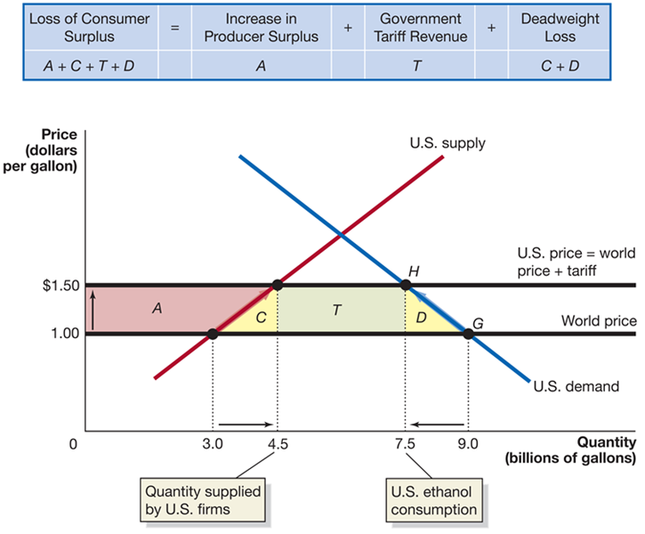
Figure 7.6 The Effects of a Tariff on Ethanol
If the government imposes a $0.50 per gallon tariff, the U.S. price rises to $1.50.
U.S. production rises, and U.S. consumption falls.
Producer surplus rises by A.
The government gains tariff revenues (T).
But consumer surplus falls by A+C+T+D.
Overall, economic surplus falls by C+D: deadweight loss.
Notes:
Without a tariff on ethanol, U.S. producers will sell 3.0 billion gallons of ethanol; U.S. consumers will purchase 9.0 billion gallons; and imports will be 6.0 billion gallons. The U.S. price will equal the world price of $1.00 per gallon. The $0.50-per-gallon tariff raises the price of ethanol in the United States to $1.50 per gallon, and U.S. producers increase the quantity they supply to 4.5 billion gallons. U.S. consumers reduce their purchases to 7.5 billion gallons. Equilibrium moves from point G to point H. The ethanol tariff causes a loss of consumer surplus equal to the area A + C + T + D. The area A is the increase in producer surplus due to the higher price. The area T is the government’s tariff revenue. The yellow areas C and D represent deadweight loss.
The table has 1 row and 7 columns. The columns have the following headings from left to right: Loss of consumer surplus = Increase in producer surplus + Government tariff revenue + Deadweight loss. The row entries are as follows: Row 1. Loss of consumer surplus A + C + T + D = Increase in producer surplus A + Government tariff revenue T + Deadweight loss C + D.
On the graph, the X-axis represents quantity in billions of gallons, and the Y-axis represents price in dollars per gallon. 4.5 represents quantity supplied by U.S. firms, and 7.5 represents U.S. ethanol consumption. A horizontal line across the graph from 1.00 represents the world price. A horizontal line across the graph from 1.50 represents the U.S. price = world price + tariff. The supply curve intersects world price at (3.0, 1.00), and the U.S. price = world price + tariff at (4.5, 1.50). The demand curve intersects world price at point G, (9.0, 1.00), and intersects U.S. price = world price + tariff at point H, (7.5, 1.50). Area A makes up the space between (0, 1.00), (0, 1.50), (4.5, 1.50), and (3.0, 1.00). Area C makes up the space between (3.0, 1.00), (4.5, 1.50), and (4.5, 1.00). Area T makes up the space between (4.5, 1.00), (4.5, 1.50), (7.5, 1.50), and (7.5, 1.00). Area G makes up the space between (7.5, 1.00), (7.5, 1.50), and (9.0, 1.00).

Slide 29
Import Quota in the U.S. Sugar Market
Quotas and voluntary export restraints are effectively similar; the difference is that quotas are imposed unilaterally (by one country), whereas V E Rs are negotiated agreements.
The United States imposes a sugar quota, allowing no more than 6.8 billion pounds of sugar to be imported.
This keeps the U.S. price of sugar ($0.36 per pound) higher than the world price ($0.18), generating large benefits for U.S. sugar producers, at the expense of U.S. sugar consumers.
On the next slide, we will calculate just how much each party is hurt or helped.

Slide 30
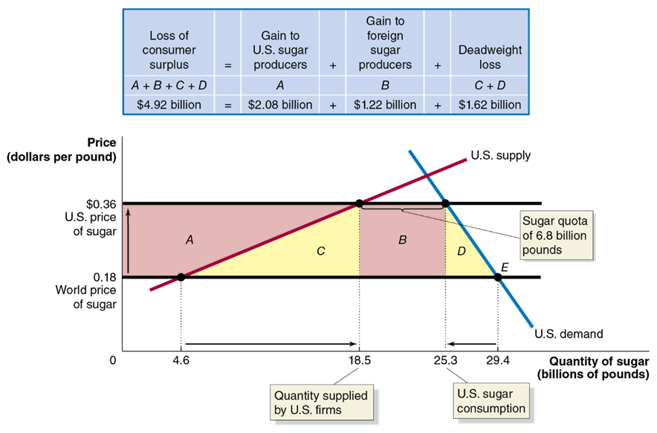
Figure 7.7 The Economic Effect of the U.S. Sugar Quota (1 of 2)
If unlimited imports were allowed, America would import almost all of the sugar it consumes.
The sugar quota restricts imports, raising the U.S. price.
Quantity supplied by U.S. firms increases, resulting in increased producer surplus (A) for U.S. firms.
Notes:
The data at the top is as follows. Loss of consumer surplus (A + B + C + D) = Gain to United States sugar producers (A) + Gain to foreign sugar producers (B) + Deadweight loss (C + D). $4.92 billion = $2.08 billion + $1.22 billion + $1.62 billion The X axis represents the quantity of sugar in billions of pounds, and the Y axis represents the price in dollars per pound. X = 18.5 represents the quantity supplied by United States firms, and x = 25.3 represents the United States sugar consumption. A horizontal line across the graph at y = 0.18 represents the world price of sugar. A horizontal line across the graph at y = 0.36 represents the United States price of sugar. The United States supply line intersects the world price of sugar line at (4.6, 0.18), and the United States price of sugar line at (18.5, 0.36). The demand line intersects the world price of sugar line at point E, (29.4, 0.18), and the United States price of sugar line at point F, (25.3, 0.36). The distance between (18.5, 0.36), and point F, (25.3, 0.36) represents the sugar quota of 6.8 billion pounds. Area A is bounded between (0, 0.18), (0, 0.36), (18.5, 0.36), and (4.6, 0.18). Area C is bounded between (4.6, 0.18), (18.5, 0.36), and (18.5, 0.18). Area B is bounded between (18.5, 0.18), (18.5, 0.18), (25.3, 0.36), and (25.3. 0.18). Area D is bounded between (25.3, 0.18), (25.3, 0.36), and (29.4, 0.18).

Slide 31
Figure 7.7 The Economic Effect of the U.S. Sugar Quota (2 of 2)
Foreign sugar producers also gain (B), by selling at the U.S. price.
Consumer surplus falls by A+C+B+D (lower consumption, higher price).
So deadweight loss of C+D occurs due to the sugar quota.
Notes:
The data at the top is as follows. Loss of consumer surplus (A + B + C + D) = Gain to United States sugar producers (A) + Gain to foreign sugar producers (B) + Deadweight loss (C + D). $4.92 billion = $2.08 billion + $1.22 billion + $1.62 billion The X axis represents the quantity of sugar in billions of pounds, and the Y axis represents the price in dollars per pound. X = 18.5 represents the quantity supplied by United States firms, and x = 25.3 represents the United States sugar consumption. A horizontal line across the graph at y = 0.18 represents the world price of sugar. A horizontal line across the graph at y = 0.36 represents the United States price of sugar. The United States supply line intersects the world price of sugar line at (4.6, 0.18), and the United States price of sugar line at (18.5, 0.36). The demand line intersects the world price of sugar line at point E, (29.4, 0.18), and the United States price of sugar line at point F, (25.3, 0.36). The distance between (18.5, 0.36), and point F, (25.3, 0.36) represents the sugar quota of 6.8 billion pounds. Area A is bounded between (0, 0.18), (0, 0.36), (18.5, 0.36), and (4.6, 0.18). Area C is bounded between (4.6, 0.18), (18.5, 0.36), and (18.5, 0.18). Area B is bounded between (18.5, 0.18), (18.5, 0.18), (25.3, 0.36), and (25.3. 0.18). Area D is bounded between (25.3, 0.18), (25.3, 0.36), and (29.4, 0.18).

Slide 32
Costs to Society From Maintaining Import Restrictions
A common argument in favor of maintaining import restrictions is that it saves domestic jobs.
Economists estimate that without the sugar import restrictions, about 3,000 jobs in the U.S. sugar industry would be lost.
That means each job’s annual cost to U.S. consumers is:
And this is probably an underestimate, since cheaper sugar would open up more jobs (in the candy industry, etc.), and encourage sugar-using manufacturers to remain in America.
Sugar producers are able to lobby for the quota because the cost to society of the quota is spread over many consumers, and the benefit is concentrated among just a few people.

Slide 33
The High Cost of Preserving Jobs with Tariffs and Quotas
The sugar quota is not the only government policy imposing a high cost on U.S. consumers to save jobs at U.S. firms:
Shoe import tariffs cost $300,000 per job, per year.
Tire tariffs cost $900,000 per job, per year.
Even worse: when one industry receives tariff or quota protection, other domestic industries lose jobs.
The 2009 tire tariff cost
jobs in retail stores because
the higher price of tires left U.S. consumers with less money to spend on other goods.

Slide 34

Apply the Concept: Smoot-Hawley and the Politics of Tariffs (1 of 3)
Tariffs on foreign-made shoes in the U.S. trace back to the 1920s:
U.S. farmers were struggling and lobbied for protection from imports.
Politicians in their districts championed these protections.
Other politicians promised their support in exchange for tariffs on other goods produced in their districts; this process is known as logrolling.

Slide 35
Apply the Concept: Smoot-Hawley and the Politics of Tariffs (2 of 3)
These negotiations resulted in the Smoot-Hawley Tariff Act (1930).
Smoot-Hawley raised tariffs to their highest
value in U.S. history
percent of the value of imports, on average)
Its effects continue to this day; e.g., the 2023 U.S. tariff on shoes contains hundreds of entries, detailing tariff levels on different types of shoes.

Slide 36
Apply the Concept: Smoot-Hawley and the Politics of Tariffs (3 of 3)
Even worse: these tariffs now protect a very small industry.
Employment in the shoe industry was 275,000 workers, now <15,000 workers.
And other countries imposed retaliatory tariffs on our exports also!
Modern trade negotiations are largely aimed at reducing these trade protections.

Slide 37
Gains From Unilateral Elimination of Tariffs and Quotas
Some politicians argue that we should drop our tariffs and quotas, but only if the other countries agree to do the same.
This makes it easier to gain political support for actions that will genuinely cause economic pain, albeit to a limited number of people.
But our analysis of the sugar quota showed that there is sufficient reason for the U.S. to unilaterally remove its restrictions.
The U.S. economy would gain from the elimination of tariffs and quotas, even if other countries did not reduce their tariffs and quotas!

Slide 38
Other Barriers to Trade
A less-common but still important barrier to trade is the restriction of imports based on health and safety standards.
Example: A government may impose higher standards on imports than it requires for domestic goods.
Many governments also restrict imports of certain products on national security grounds, fearing that in times of war, they would not have access to those products.
Example: The Defense Department gives army recruits a voucher for a new pair of sneakers; New Balance lobbied (unsuccessfully) for these to be restricted to U.S.-made sneakers.
Example: In 2021, President Biden expanded the “Buy American” program partly on national security grounds, arguing (for example) that personal protective equipment (P P E) might become unavailable for import during a future pandemic.

Slide 39
7.5 The Debate over Trade Policies and Globalization
Evaluate the debate over trade policies and globalization.
More trade takes place between nations when their governments encourage rather than discourage it.
As trade generally makes nations better off, economists are generally in favor of freer trade.
But there are many people who do not believe free trade makes everyone better off and so oppose it.

Slide 40
Trade Agreements in the 21st Century
1930: U.S. institutes Smoot-Hawley Tariff, increasing tariffs to >50 percent. Goal is to “protect” domestic industry, encourage employment. Other countries retaliate with their own restrictions.
1948: Western countries seeking to revive international trade form G A T T (General Agreement on Tariffs and Trade). Several “rounds” of multilateral tariff reduction followed.
1995: World Trade Organization (W T O) replaces G A T T; 159 member states, as of 2023, agree to liberalize international trade. W T O also provides dispute resolution process for trade disputes. Better coverage for non-physical products (ex: intellectual property).
World Trade Organization (W T O): An international organization that oversees international trade agreements.

Slide 41
Opposition to W T O and Trade in General (1 of 2)
Some people oppose changes in economies and cultures caused by globalization.
Globalization: The process of countries becoming more open to foreign trade and investment.
Low-income countries have less strict regulations including worker protections, creating a perception of unfairness.
But regulations are a choice; in rich countries, we choose such regulations because we think they make us better off.
Free trade and foreign investment might “destroy” distinctive cultures.
Whether low-income countries are better off with McDonalds and Walmart is debatable; but if they want to eat and shop there, should we deny them that right? These are normative questions.

Slide 42
Opposition to W T O and Trade in General (2 of 2)
An older argument against trade comes from “old-fashioned” protectionists.
Protectionism: The use of trade barriers to shield domestic firms from foreign competition.
Restricting trade “saves jobs” and “protects high wages”
We have seen that, overall, people are better off with trade, even though some individuals are worse off.
“Infant industries” need protection
Industries might need some time to “start up” and become competitive; but tariffs must eventually be removed.
Protecting national security
Maybe we shouldn’t import all our guns, computer microchips, or fighter planes from elsewhere…

Slide 43
Apply the Concept: Should We Use Tariffs to Slow Climate Change? (1 of 2)
In 2021, The U.S. and E.U. began exploring tariffs on steel from countries with lax environmental regulations. These carbon border adjustment mechanisms (C B A M s) would level the playing field for domestic steel producers who must comply with more stringent regulations, raising the cost of producing steel for U.S. and E.U. firms.
Imported steel results in 50-100% more carbon dioxide emissions than domestically-produced steel.

Slide 44
Apply the Concept: Should We Use Tariffs to Slow Climate Change? (2 of 2)
Critics of this approach argue:
Previous attempts to use economic coercion to change other countries’ policies have not generally been successful.
While climate change may be used as an excuse, it just disguises the true anti-trade, protectionist goals of policymakers.
The W T O does not authorize tariffs for climate change reasons, so retaliatory tariffs from other countries may result.
In December 2022, the European Union did announce a C B A M on some products, including steel; the U.S. has not done so, perhaps out of concern that it would raise prices during a time of high inflation.

Slide 45
Dumping
In recent years, the U.S. has protected some domestic industries using a W T O provision against dumping.
Dumping: Selling a product for a price below its cost of production.
In practice it is difficult to tell if foreign companies are dumping goods; true production costs are not easy for governments to calculate.
W T O’s approach: Countries can claim dumping if products are exported for a lower price than they are sold domestically.
This standard is arbitrary; companies might use loss-leaders or different prices in different markets in order to maximize profits.
It’s unclear why these normal business practices should be unacceptable when used in international trade.

Slide 46
Positive versus Normative Analysis
Recall positive analysis reflects “what is” and normative analysis “what ought to be.”
Judgments about free trade necessarily reflect values and morals.
Though most economists do not support interference with trade, it is possible to value the costs of free trade more highly than the benefits, and hence believe free trade is undesirable.

Slide 47
Political Economy and Trade Restrictions
While the costs of tariffs and quotas to consumers may be large, they are spread across many people. The sugar quota makes U.S. consumers about $4.92 billion worse off per year, but this equates to only about $15 per person.
Sugar producers gain $2.08 billion per year; but those gains go to relatively few people, who loudly support the quota.
Similarly, the jobs lost to foreign competition are easy to identify, while the jobs created by foreign trade are less so.
The concentration of benefits from trade restrictions, and low pressure from the public to reduce them, make many politicians reluctant to oppose those restrictions.

Slide 48
Building Bridges Versus Walls
Building walls against economic change preserve jobs and profits for a few, with large costs for the rest of us.
Hungarian economist Nicholas Kaldor argued instead that the winners from increased economic efficiency should compensate the losers.
Such bridges to a brighter economic future for those affected by international trade could include increased funding for retraining and tax credits for firms that invest in skill development for their workers.

Slide 49

Copyright
This work is protected by United States copyright laws and is provided solely for the use of instructors in teaching their courses and assessing student learning. Dissemination or sale of any part of this work (including on the World Wide Web) will destroy the integrity of the work and is not permitted. The work and materials from it should never be made available to students except by instructors using the accompanying text in their classes. All recipients of this work are expected to abide by these restrictions and to honor the intended pedagogical purposes and the needs of other instructors who rely on these materials.

